Slide 1

TARGET FOLDER
SRNTGT101
Severomorsk SAM Factory, SRN
SECRET - DCS WORLD
REL TO COALITION
SECRET - DCS WORLD
REL TO COALITION

Slide 2

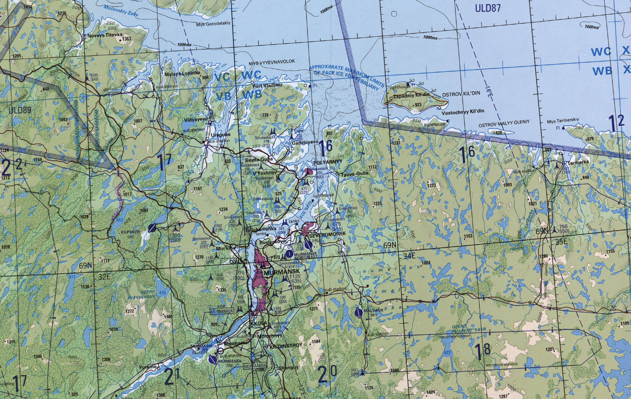
Severomorsk SAM Factory, SRN
OPAC CLASSIFIED REL TO CJTF-23
JOINT OPERATIONS GRAPHIC 1/1
MAP
OVERVIEW
BE: SRNTGT101 CATCODE: 9
MIDB GEO: N 69 03.636 E 033 26.451
ICOD: 2011-JUL-06 DOI:2011-JUL-05
DECL ON: 2061-JUL-06
N
Severomorsk
SAM Factory SRNTGT101
.

Slide 3
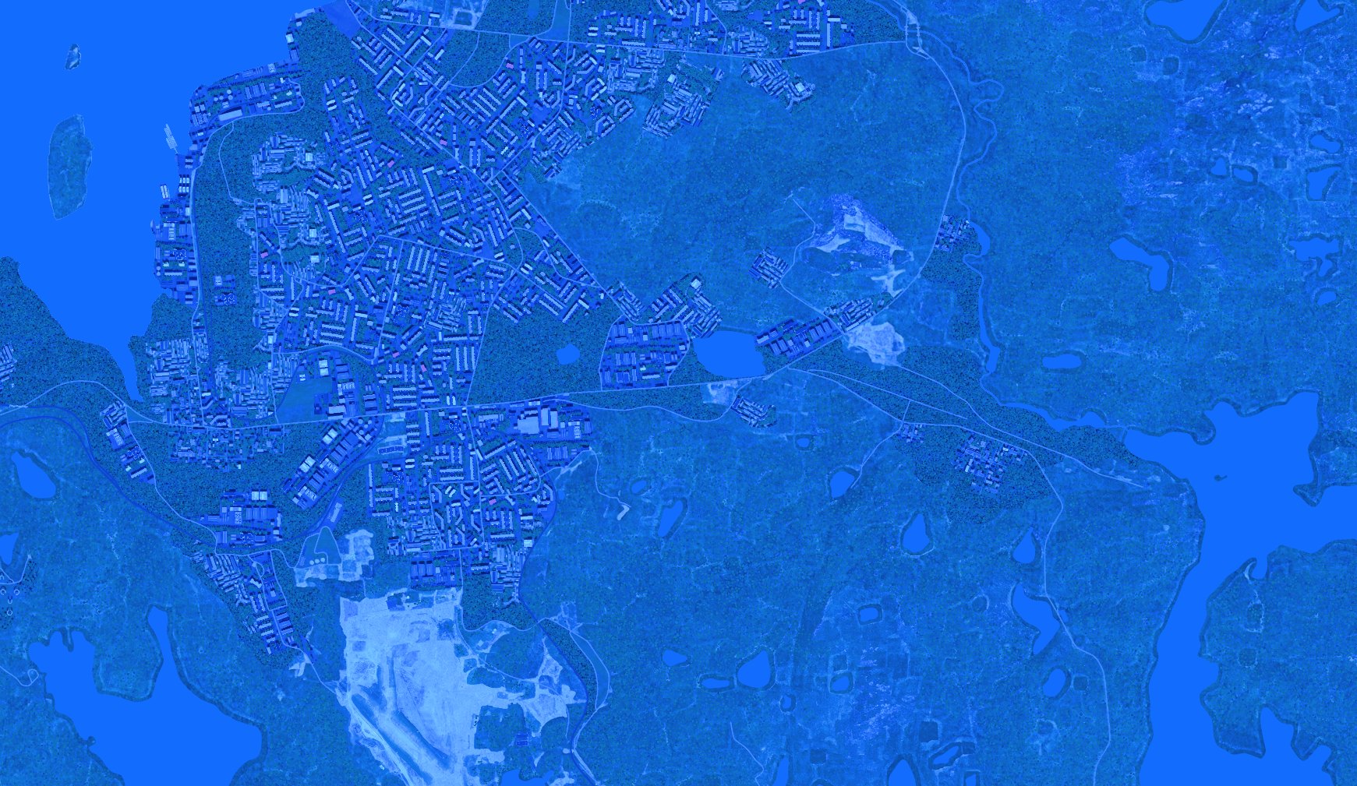
Severomorsk SAM Factory, SRN
OPAC CLASSIFIED REL TO CJTF-23
FACILITY OUTLINE GRAPHIC 1/1
MAP
OVERVIEW
BE: SRNTGT101 CATCODE: 9
MIDB GEO: N 69 03.636 E 033 26.451
ICOD: 2011-JUL-06 DOI:2011-JUL-05
DECL ON: 2061-JUL-06
N
Severomorsk SAM Factory SRNTGT101

Slide 4
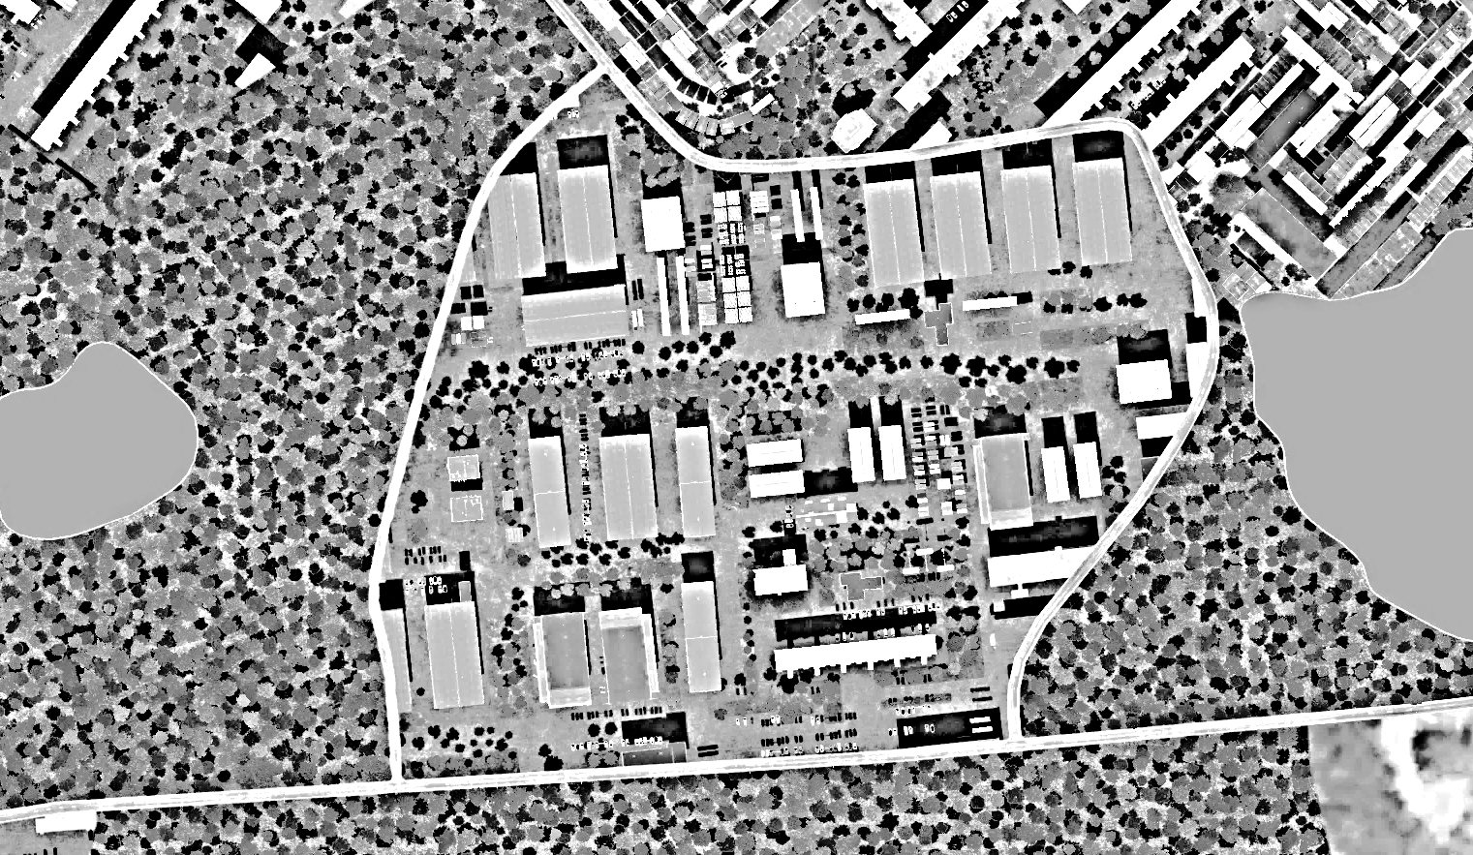
Severomorsk SAM Factory, SRN
OPAC CLASSIFIED REL TO CJTF-23
JOINT DESIRED POINT OF IMPACT GRAPHIC 1/1
MAP
OVERVIEW
BE: SRNTGT101 CATCODE: 9
MIDB GEO: N 69 03.636 E 033 26.451
ICOD: 2011-JUL-06 DOI:2011-JUL-05
DECL ON: 2061-JUL-06
DPI: C
C2 PRODUCTION ON GRN
N 69 03.715 E 033 26.366
DPI MSL: 146 FT
DPI: H
CHEMICAL STORAGE ON GRN
N 69 03.716 E 033 26.460
JDPI MSL: 145 FT
DPI: I 2
CHEMICAL STORAGE ON GRN
N 69 03.684 E 033 26.390
JDPI MSL: 152 FT
N
DPI: I 1
CHEMICAL STORAGE ON GRN
N 69 03.691 E 033 26.392
DPI MSL: 150 FT
DPI: B
RADAR PRODUCTION ON GRN
N 69 03.686 E 033 26.477
JDPI MSL: 152 FT
DPI: G1
POWER DISTRIB FACILITY ON GRN
N 69 03.651 E 033 26.150
DPI MSL: 159 FT
DPI: A
RADAR PRODUCTION ON GRN
N 69 03.635 E 033 26.762
JDPI MSL: 173 FT
DPI: G2
POWER DISTRIB FACILITY ON GRN
N 69 03.639 E 033 26.144
DPI MSL: 161 FT
DPI: D
SA10 PRODUCTION ON GRN
N 69 03.613 E 033 26.623
JDPI MSL: 186 FT
DPI: E
SA10 PRODUCTION ON GRN
N 69 03.582 E 033 26.260
DPI MSL: 174 FT
DPI: J
ADMIN & HQ BUILDING ON GRN
N 69 03.590 E 033 26.474
JDPI MSL: 167 FT
DPI: F
SA10 PRODUCTION ON GRN
N 69 03.585 E 033 26.202
DPI MSL: 175 FT

Slide 5
Severomorsk SAM Factory, SRN
OPAC CLASSIFIED REL TO CJTF-23
WEAPONEERING OPTIONS 1/1
MAP
OVERVIEW
BE: SRNTGT101 CATCODE: 9
MIDB GEO: N 69 03.636 E 033 26.451
ICOD: 2011-JUL-06 DOI:2011-JUL-05
DECL ON: 2061-JUL-06
JDPI | DESCRIPTION | TLE | WARHEAD | GUIDANCE | DESIRED EFFECT | IMPACT ANGLE | FUZING
A | RADAR PRODUCTION PLANT 1 | CAT 2 | 1000 lbs | DECIMETRIC | BLAST, FRAGMENTATION | 60-90 | 25ms
B | RADAR PRODUCTION PLANT 2 | CAT 2 | 1000 lbs | DECIMETRIC | BLAST, FRAGMENTATION | 60-90 | 25ms
C | C2 NODE PRODUCTION PLANT | CAT 2 | 1000 lbs | DECIMETRIC | BLAST, FRAGMENTATION | 60-90 | 25ms
D | SA LAUNCHER PRODUCTION PLANT | CAT 2 | 1000 lbs | DECIMETRIC | BLAST, FRAGMENTATION | 60-90 | 25ms
E | SA LAUNCHER PRODUCTION PLANT | CAT 2 | 1000 lbs | DECIMETRIC | BLAST, FRAGMENTATION | 60-90 | 25ms
F | SA LAUNCHER PRODUCTION PLANT | CAT 2 | 1000 lbs | DEMIMETRIC | BLAST, FRAGMENTATION | 60-90 | 25ms
G1 | POWER DISTRIBUTION FACILITY 1 | CAT 2 | 1000 lbs | METRIC | BLAST, FRAGMENTATION | 60-90 | 25ms
G2 | POWER DISTRIBUTION FACILITY 2 | CAT 2 | 1000 lbs | METRIC | BLAST, FRAGMENTATION | 60-90 | 25ms
H | CHEMICAL STORAGE | CAT 2 | 1000 lbs | METRIC | BLAST, FRAGMENTATION | 60-90 | 0ms
I1 | CHEMICAL STORAGE | CAT 2 | 1000 lbs | METRIC | BLAST, FRAGMENTATION | 60-90 | 0ms
I2 | CHEMICAL STORAGE | CAT 2 | 1000 lbs | METRIC | BLAST, FRAGMENTATION | 60-90 | 0ms
J | ADMIN & HQ BUILDING | CAT 2 | 2000 lbs | METRIC | BLAST, FRAGMENTATION | 60-90 | 25ms

Slide 6
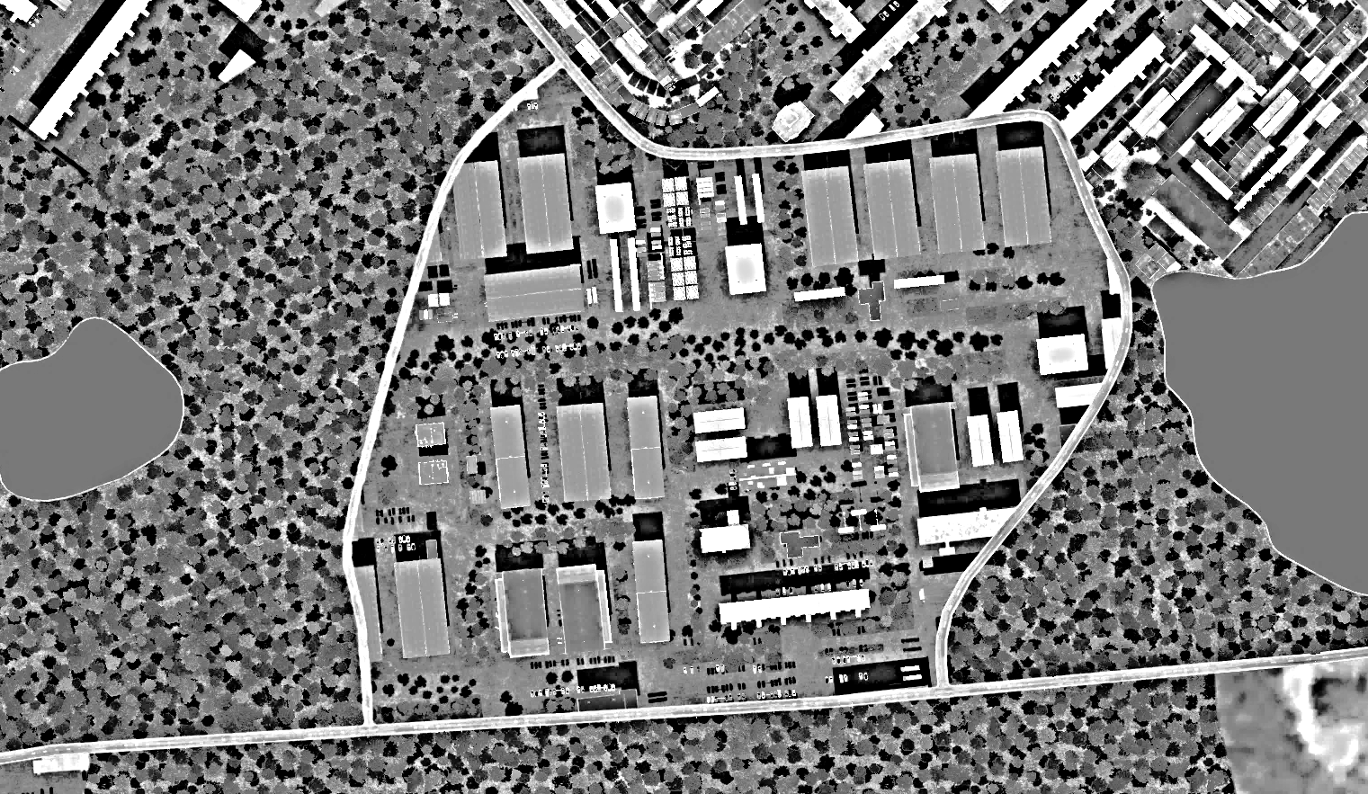
Severomorsk SAM Factory, SRN
OPAC CLASSIFIED REL TO CJTF-23
COLLATERAL DAMAGE ESTIMATION GRAPHIC [X]
MAP
OVERVIEW
BE: SRNTGT101 CATCODE: 9
MIDB GEO: N 69 03.636 E 033 26.451
ICOD: 2011-JUL-06 DOI:2011-JUL-05
DECL ON: 2061-JUL-06
400ft
N
NCC: Civilian Office
250 FT N FROM DPI B
DPI B
[CLASSIFICATION]
[DISSEMINATION CONTROLS]
[CDE]

Slide 7
Severomorsk SAM Factory, SRN
OPAC CLASSIFIED REL TO CJTF-23
COLLATERAL DAMAGES ESTIMATION 1/1
MAP
OVERVIEW
BE: SRNTGT101 CATCODE: 9
MIDB GEO: N 69 03.636 E 033 26.451
ICOD: 2011-JUL-06 DOI:2011-JUL-05
DECL ON: 2061-JUL-06
COLLATERAL DAMAGES WITHIN A 500M RADIUS
DESCRIPTION |  | CATCODE | MIDB GEOS | LOCATION | REMARKS
Civilian Office Block |  | 14 |  | 250ft N DPI B | Potential Civilian Casualties
NO STRIKE ENTITIES WITHIN A 500M RADIUS
NSE ID | DESCRIPTION | CATCODE | MIDB GEOS | LOCATION | REMARKS

Slide 8
Severomorsk SAM Factory, SRN
OPAC CLASSIFIED REL TO CJTF-23
BATTLE DAMAGE ASSESSMENT GRAPHIC [X]
MAP
OVERVIEW
BE: SRNTGT101 CATCODE: 9
MIDB GEO: N 69 03.636 E 033 26.451
ICOD: 2011-JUL-06 DOI:2011-JUL-05
DECL ON: 2061-JUL-06
POST-STRIKE
PRE-STRIKE
N
TARGET OBJECTIVE
DAMAGE/CHANGE ASSESSMENT
JDPI:[XXXXXX]
BDA REMARK: [CLASSIFICATION] [DISSEMINATION] Assessment: Physical Damage/change, Collateral Damage, Functional Damage/change, Munitions Effectiveness, Reattack Recommendation, Additional/Collateral Effects

Slide 9

ACRONYMS
ACRONYM | MEANING | DEFINITION
BE | Basic Encyclopedia Number | Alpha/numeric code unique to an installation for incorporation within various national and tactical systems.
CATCODE | Category Code | The data Element that classifies the function and purpose of an installation or a facility.
MIDB | Modernized Integrated Database | A database comprised of information on facilities of military significance, military forces, and related equipment.
ICOD | Intelligence Cut Off Date | The date of the latest intelligence data inputted to a feature.
DOI | Date of Image | Date on which a geospatial or intelligence-related image was captured.
CE | Critical Element | An element of an entity or object that enables it to perform its primary function.
PV CHAR | Physical Vulnerability Characteristic | Standardized alphanumeric code describing the physical and structural properties of a target.
JDPI | Joint Desired Point of Impact | A unique, alphanumeric coded aimpoint identified by a three dimensional mensurated point. It represents a weapon or capability desired point of impact or penetration.
CE90 | Circular Error at 90% | 90 percent confidence level in the horizontal plane.
LE90 | Linear Error at 90% | 90 percent confidence level in the vertical dimension
MSL | Mean Sea Level | Elevation above Earth reference geoid.
AGL | Above Ground Level | Elevation above ground surface.
NCC | Nearest Collateral Concern | Closest non-targeted structure, area, or entity near a planned point of impact that may be at risk of unintended damage during a military strike.
CER | Collateral effects radius | Radius within which collateral damage might happen based on the weapon's characteristics, the target environment, and other operational factors.
CDE | Collateral damage estimate | Systematic process used in military targeting to evaluate the potential for unintended damage or harm to non-combatant entities, structures, or personnel as a result of a planned strike.
NSE | No Strike Element | Specific entities, locations, or objects that are protected from intentional targeting under the Law of Armed Conflict (LOAC) or by operational policy.

Slide 10
MILITARY KILL EFFECTS
Definition: destructive effects available upon detonation of a weapon.
KILL EFFECT |  | DEFINITION
BLAST |  | The high-pressure shockwave created by an explosion, traveling outward from the detonation point. Blast effects cause destruction by overpressure (compression force) and dynamic pressure (wind generated by the expanding gases), which can demolish structures, damage equipment, and injure personnel.
FRAGMENTATION |  | The dispersal of shrapnel or debris from an exploding munition. Fragments are propelled outward at high velocity, targeting personnel, equipment, and light structures in the area of effect.
PENETRATION |  | The effect of a munition or projectile piercing a target's surface without fully passing through it. Penetration is often used to defeat hardened targets, such as bunkers, by transferring energy into the target's structural layers.
INCENDIARY |  | The combustion of materials caused by incendiary munitions, secondary explosions, or the heat from a blast. Fire destroys flammable materials and can cause secondary damage to structures and equipment, as well as injuries to personnel.
CRATERING |  | The formation of a crater in the ground caused by the impact or detonation of a munition. Cratering disrupts mobility and operations, damaging roads, runways, or creating obstacles in the battlefield.
PERFORATION |  | The complete passage of a munition or projectile through a target, creating both an entry and exit point. Perforation may reduce the energy transfer to the target, making it less effective for destroying heavily armored or reinforced structures.
EARTH SHOCK |  | The seismic-like vibrations transmitted through the ground from an explosion. Earth shock can damage underground structures, destabilize foundations, or incapacitate personnel in subterranean environments.
NUCLEAR RADIATION |  | The release of ionizing radiation (alpha, beta, gamma, and neutron particles) from a nuclear explosion. Nuclear radiation can cause immediate biological damage, long-term health effects, and contamination of the environment.
THERMAL RADIATION |  | The intense heat and light energy emitted by an explosion, especially in nuclear detonations. Thermal radiation causes burns, ignites materials, and can create secondary fires in the target area.

